Slide 1
Final Project Presentation
Advanced SQL
(Summer 2025)
Case Study: Design & Query a Mini Data Warehouse (Best Buy Electronic Store)
Group 4
Ritul Soni
May Thu
Nway Ei Zaw

Slide 2
Agenda
Introduction & Business Context
Architecture (OLTP vs OLAP)
Design & Data (ERD 3NF + Star Schema)
Core Queries
Views & ‘Materialized’ View
Transactions & Concurrency
Performance Optimization
Conclusion

Slide 3
Introduction (Best Buy Context)
This project was developed as part of the Advanced SQL course. The goal was to design and implement a mini data warehouse for a fictional retail company modeled after Best Buy. The project demonstrates skills in database design, complex querying, transactions, concurrency handling, and performance optimization.
The Best Buy case was chosen because it represents a realistic, large-scale retail environment, handling online and in-store sales, customer reviews, and supplier management.

Slide 4
Architecture Overview
Two layers
OLTP (3NF): orders, order lines, products, customers, employees, payments
OLAP (Star): FactSales (grain: one order line) + DimDate/Customer/Product/Employee/Location ETL: periodic movement from OLTP → OLAP for reporting
Business Flow
Customer places an order → system validates stock.
Order processed by employee → stored in Orders and Order_Details.
Inventory updated → stock decremented, preventing overselling.
Payment & shipment recorded → ensures end-to-end transaction tracking.
Data periodically moved into OLAP layer → fact/dimension tables for reporting.
This flow supports both operational efficiency (fast order processing) and strategic insights (trend analysis, top products, sales forecasts).

Slide 5
Design and Data
ER Diagram Entities
Relationship | Type | Description
Customers → Orders | 1:M | A customer can place many orders.
Orders → OrderDetails | 1:M | Each order can have multiple line items.
Products → OrderDetails | 1:M | Each product can appear in many order details.
Suppliers → Products | 1:M | A supplier provides many products.
Employees → Orders | 1:M | An employee can process many orders.
Orders → Payments | 1:1 | Each order has one payment record.
Products → Inventory | 1:M | Each product can exist in multiple locations.
Products → Reviews | 1:M | A product can have multiple reviews.
Customers → Reviews | 1:M | A customer can leave many reviews.
Orders → Shipments | 1:1 or 1:M | Each order can have one or multiple shipments (depends on split shipments).

Slide 6
Design and Data
3NF Tables
Table | PK | FK | Purpose
Customers | CustomerID | None | Stores customer personal details and address.
Products | ProductID | SupplierID → Suppliers | Stores product details like name, price, model year.
Suppliers | SupplierID | None | Stores supplier company and contact information.
Employees | EmployeeID | None | Tracks employees handling orders.
Orders | OrderID | CustomerID → Customers, EmployeeID → Employees | Stores order header data (date, status).
OrderDetails | OrderDetailID (or composite OrderID + ProductID) | OrderID → Orders, ProductID → Products | Stores each item sold in an order.
Payments | PaymentID | OrderID → Orders | Records payments for orders.
Inventory | InventoryID | ProductID → Products | Tracks product stock at different locations.
Reviews | ReviewID | CustomerID → Customers, ProductID → Products | Stores customer reviews and ratings.
Shipments | ShipmentID | OrderID → Orders | Tracks shipment details (carrier, tracking, status).

Slide 7
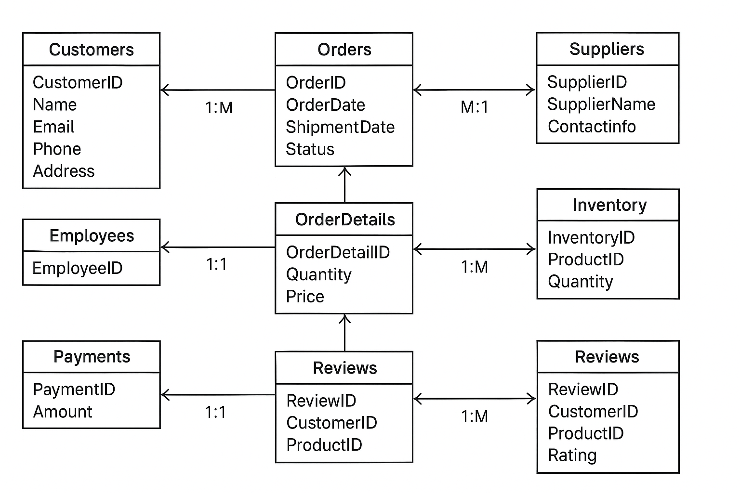
Design and Data
Finalized ER Diagram

Slide 8
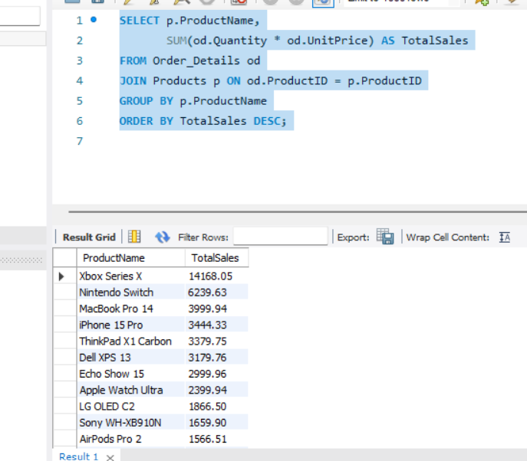
Core Query
Example 1: Total Sales Per Product (with JOIN and GROUP BY)
Full Version of the 9 Core Queries in the Documentation File
SELECT p.ProductName,
SUM(od.Quantity * od.UnitPrice) AS TotalSales
FROM Order_Details od
JOIN Products p ON od.ProductID = p.ProductID
GROUP BY p.ProductName
ORDER BY TotalSales DESC;
Result:
Business effect:
Shows which products bring in the most revenue.
Helps management focus on high-performing items or promote low-performing ones.

Slide 9
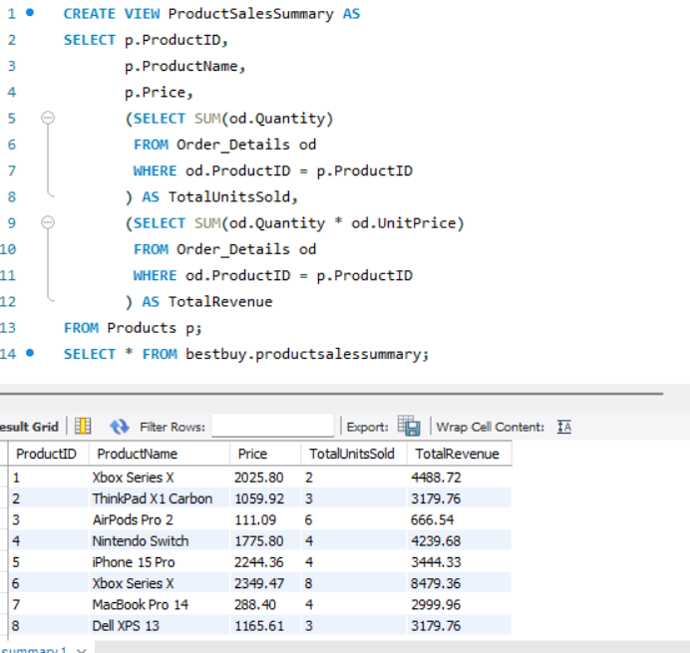
Views & “Materialized” View
Business Impact:
Provides quick insights into product performance without repeatedly writing complex queries.
Supports inventory planning, promotions, and supplier negotiations.
Regular View: Product Sales Summary
Product Sales Summary
CREATE VIEW ProductSalesSummary AS
SELECT p.ProductID,
p.ProductName,
p.Price,
(SELECT SUM(od.Quantity)
FROM Order_Details od
WHERE od.ProductID = p.ProductID
) AS TotalUnitsSold,
(SELECT SUM(od.Quantity * od.UnitPrice)
FROM Order_Details od
WHERE od.ProductID = p.ProductID
) AS TotalRevenue
FROM Products p;
Result:

Slide 10
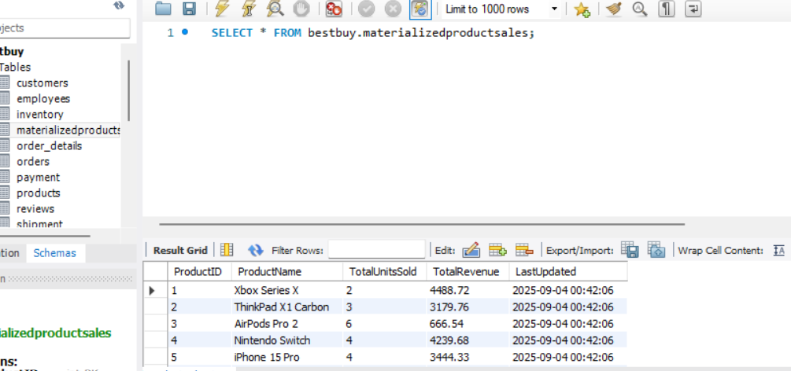
Views & “Materialized” View
Business Impact:
Provides pre-aggregated product sales data for faster reporting.
Reduces computation time for dashboards or frequent reports.
Can be scheduled (e.g., daily via MySQL Event Scheduler) to always have up-to-date data.
Simulated Materialized View
Product Sales Summary
Step 1: Create the table
CREATE TABLE MaterializedProductSales (
ProductID INT PRIMARY KEY,
ProductName VARCHAR(100),
TotalUnitsSold INT,
TotalRevenue DECIMAL(10,2),
LastUpdated TIMESTAMP DEFAULT CURRENT_TIMESTAMP
);
Step 2: Stored procedure to refresh data
DELIMITER //
CREATE PROCEDURE RefreshMaterializedProductSales()
BEGIN
TRUNCATE TABLE MaterializedProductSales;
INSERT INTO MaterializedProductSales (ProductID, ProductName, TotalUnitsSold, TotalRevenue)
SELECT p.ProductID,
p.ProductName,
IFNULL(SUM(od.Quantity), 0),
IFNULL(SUM(od.Quantity * od.UnitPrice), 0)
FROM Products p
LEFT JOIN Order_Details od ON p.ProductID = od.ProductID
GROUP BY p.ProductID, p.ProductName;
END //
DELIMITER ;
Step 3: Call the procedure to refresh the table
CALL RefreshMaterializedProductSales();
Result:

Slide 11
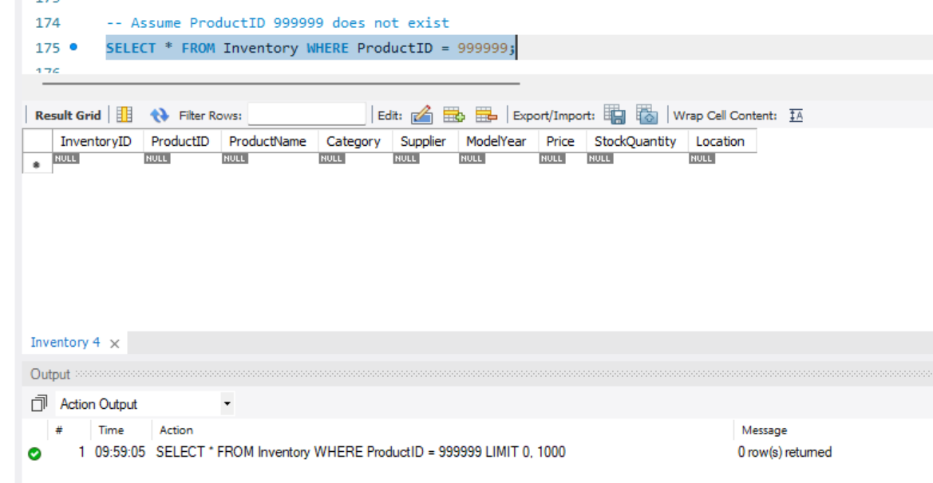
Transactions & Concurrency
Stored procedure: place a (single-product) order with inventory check + error handling
🧪 Demo Scenarios
A) Product Not Found
-- Assume ProductID 999999 does not exist
SELECT * FROM Inventory WHERE ProductID = 999999;
Before:

Slide 12
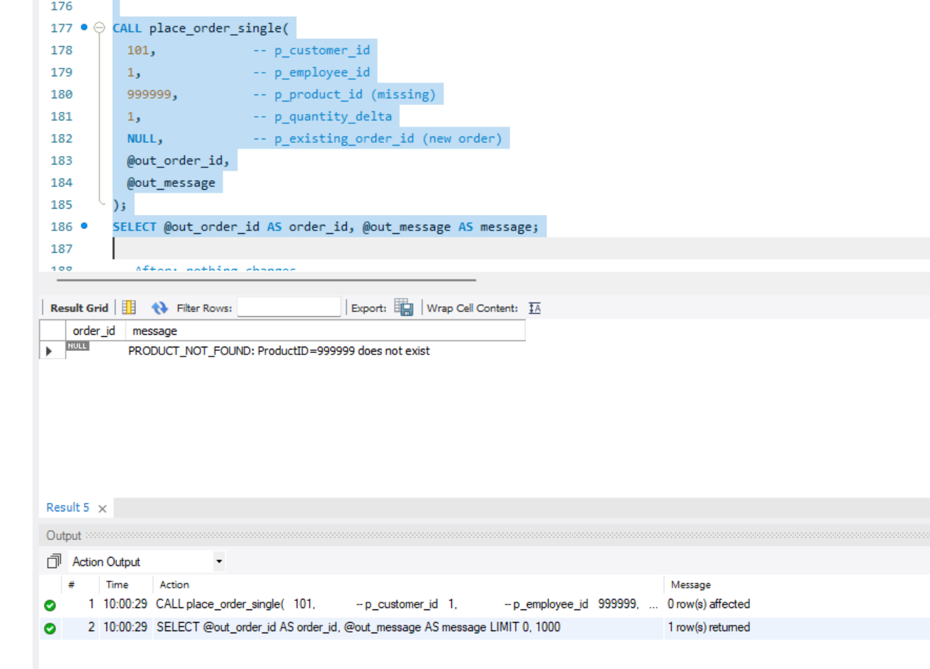
Transactions & Concurrency
Stored procedure: place a (single-product) order with inventory check + error handling
🧪 Demo Scenarios
CALL place_order_single(
101, -- p_customer_id
1, -- p_employee_id
999999, -- p_product_id (missing)
1, -- p_quantity_delta
NULL, -- p_existing_order_id (new order)
@out_order_id,
@out_message
);
SELECT @out_order_id AS order_id, @out_message AS message;
After:

Slide 13
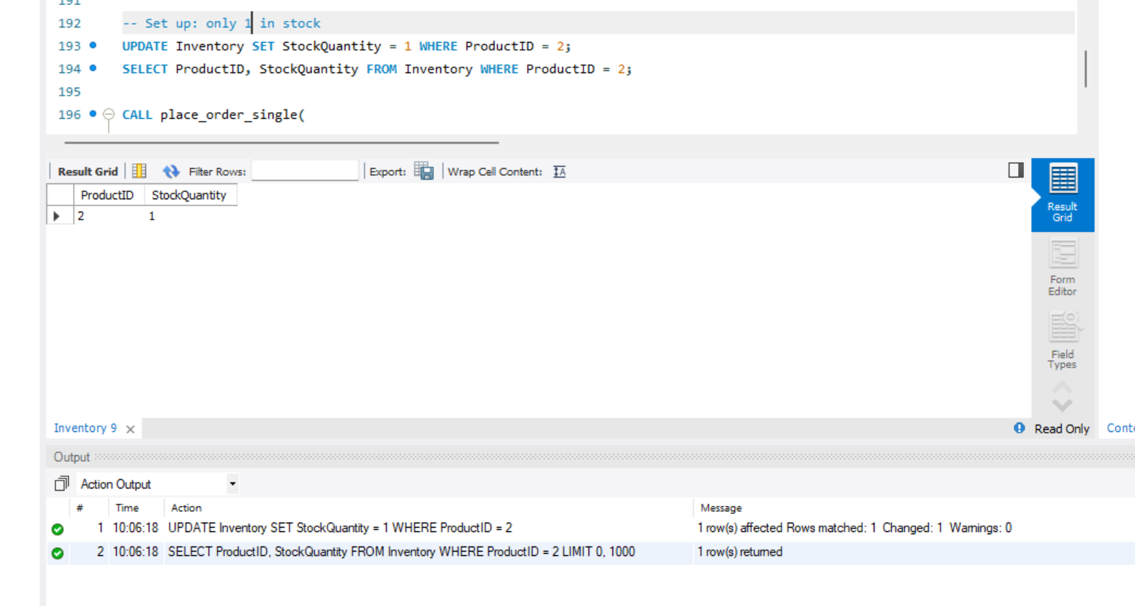
Transactions & Concurrency
Stored procedure: place a (single-product) order with inventory check + error handling
🧪 Demo Scenarios
B) Insufficient Stock
-- Set up: only 1 in stock
UPDATE Inventory SET StockQuantity = 1 WHERE ProductID = 2;
SELECT ProductID, StockQuantity FROM Inventory WHERE ProductID = 2;
Before:

Slide 14
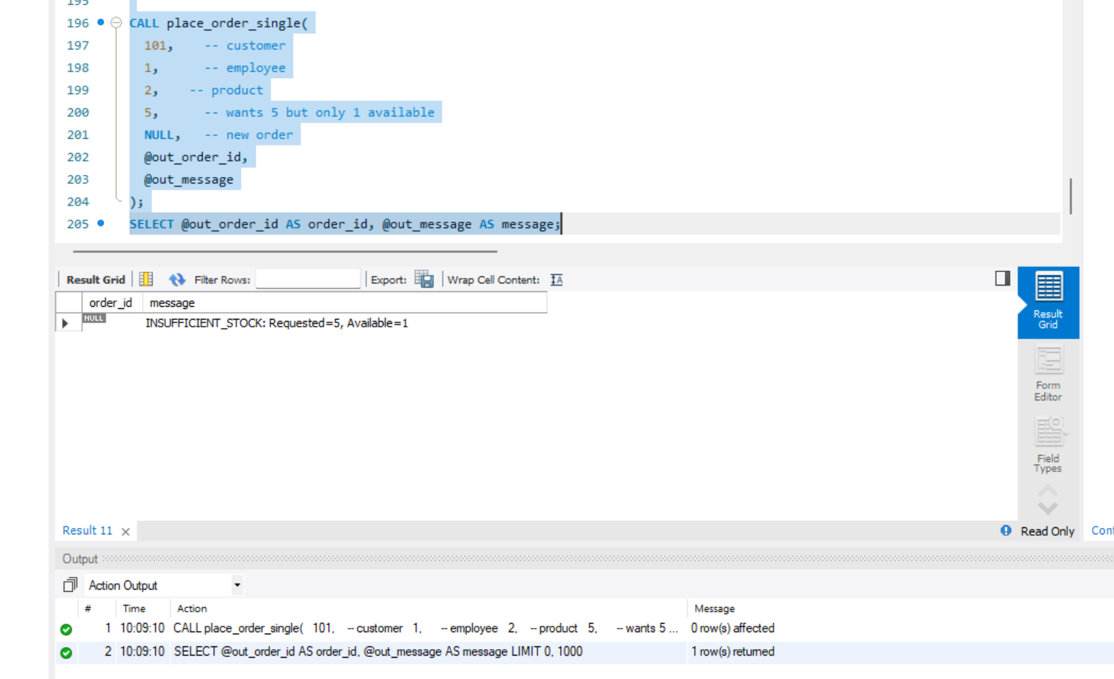
Transactions & Concurrency
Stored procedure: place a (single-product) order with inventory check + error handling
🧪 Demo Scenarios
CALL place_order_single(
101, -- customer
1, -- employee
2, -- product
5, -- wants 5 but only 1 available
NULL, -- new order
@out_order_id,
@out_message
);
SELECT @out_order_id AS order_id, @out_message AS message;
After:

Slide 15
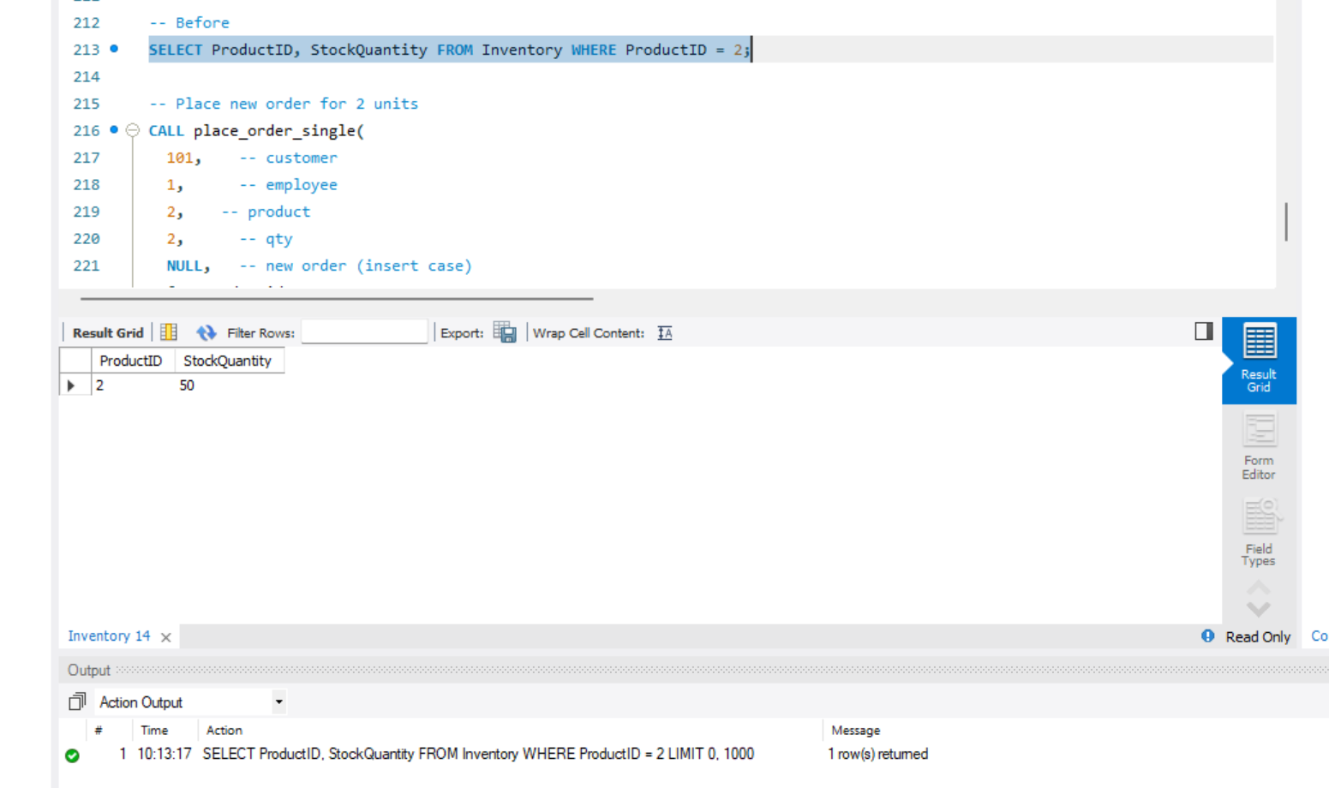
Transactions & Concurrency
Stored procedure: place a (single-product) order with inventory check + error handling
🧪 Demo Scenarios
C) SUCCESS INSERT (New Order)
-- Set up: enough stock
UPDATE Inventory SET StockQuantity = 50, Price = 999.00 WHERE ProductID = 2;
-- Before
SELECT ProductID, StockQuantity FROM Inventory WHERE ProductID = 2;
Before:

Slide 16
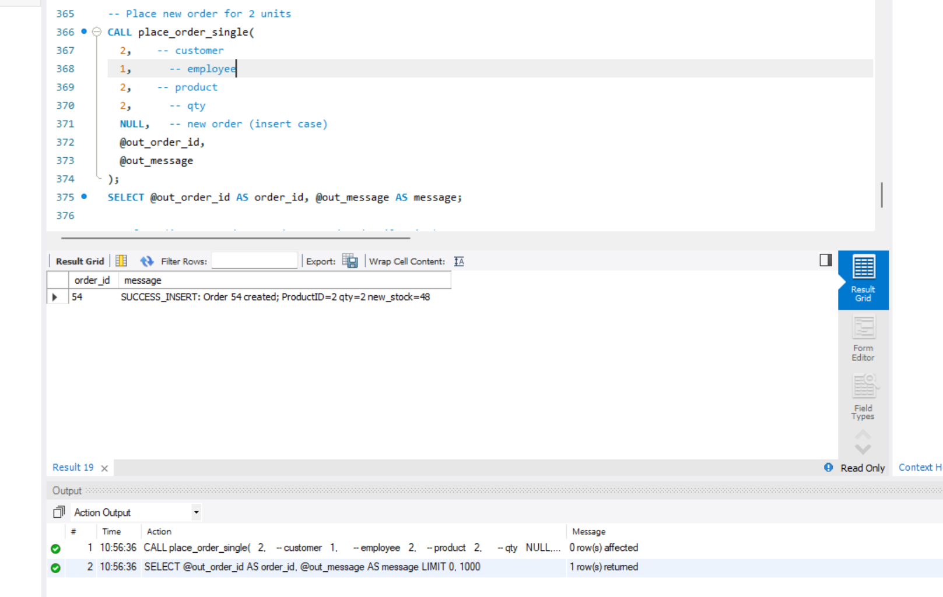
Transactions & Concurrency
Business effect / impact
Atomicity: The purchase, the inventory decrement, and order detail insert happen as a single atomic unit. If any part fails (e.g., low stock), the procedure rolls back and no partial state remains.
Data integrity: Prevents overselling because we lock the inventory row (FOR UPDATE) and check stock before committing.
Stored procedure: place a (single-product) order with inventory check + error handling
🧪 Demo Scenarios
-- Place new order for 2 units
CALL place_order_single(
101, -- customer
1, -- employee
2, -- product
2, -- qty
NULL, -- new order (insert case)
@out_order_id,
@out_message
);
SELECT @out_order_id AS order_id, @out_message AS message;
After:

Slide 17
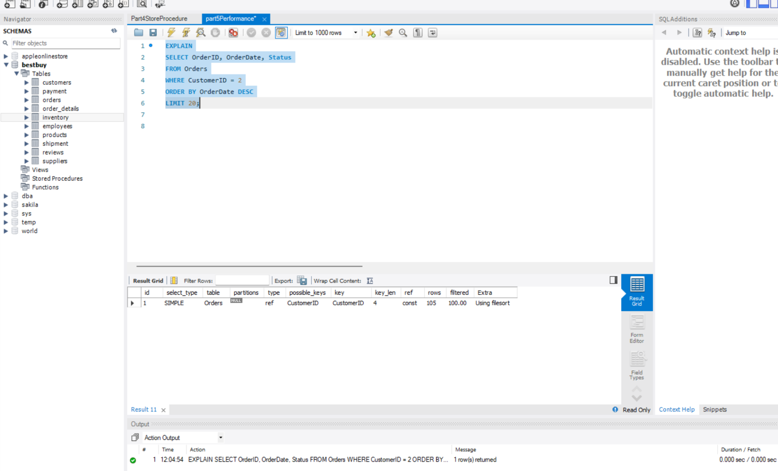
Performance Optimization
Typical BEFORE pattern
type: ref (on CustomerID if it has an index) or ALL (full scan) if not
Extra: Using filesort (because it must sort by OrderDate)
Higher rows estimate
Case A — “Recent Orders for a Customer” (avoid filesort + table scan)
Business question: “Show a customer’s last 20 orders by date.”
BEFORE (no composite on (CustomerID, OrderDate))
EXPLAIN
SELECT OrderID, OrderDate, Status
FROM Orders
WHERE CustomerID = 101
ORDER BY OrderDate DESC
LIMIT 20;
Result

Slide 18
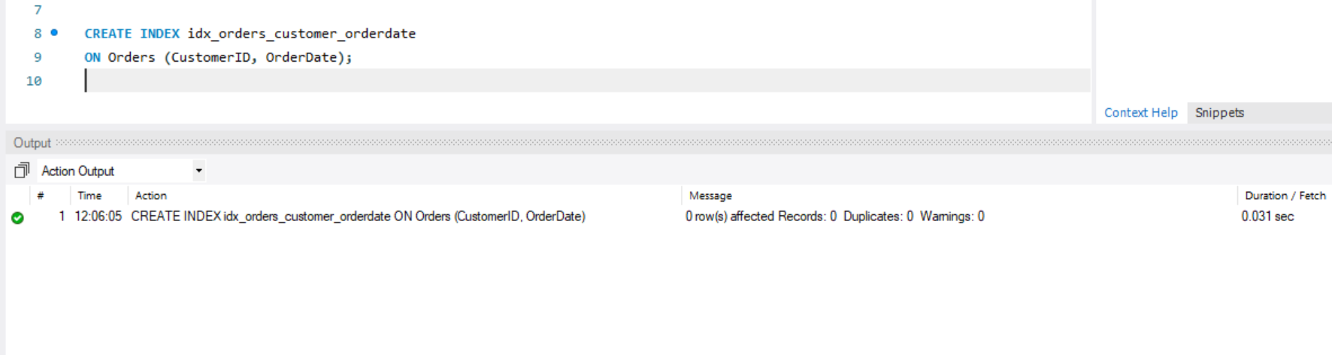
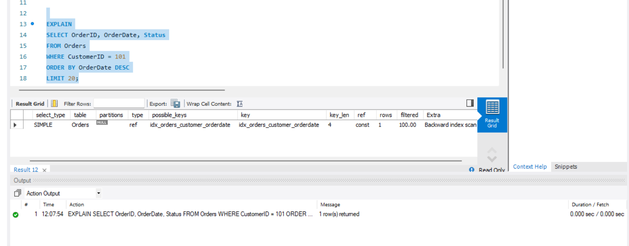
Performance Optimization
Case A — “Recent Orders for a Customer” (avoid filesort + table scan)
Business question: “Show a customer’s last 20 orders by date.”
Create index (AFTER)
CREATE INDEX idx_orders_customer_orderdate
ON Orders (CustomerID, OrderDate);
Expected AFTER pattern
type: ref or range
No Using filesort (reads in index order)
Fewer rows examined
Business effect
Faster “My Orders” page and customer service lookups
Lower CPU/IO due to index order scan (no extra sort)
Helps meet SLA during peak traffic
Result

Slide 19
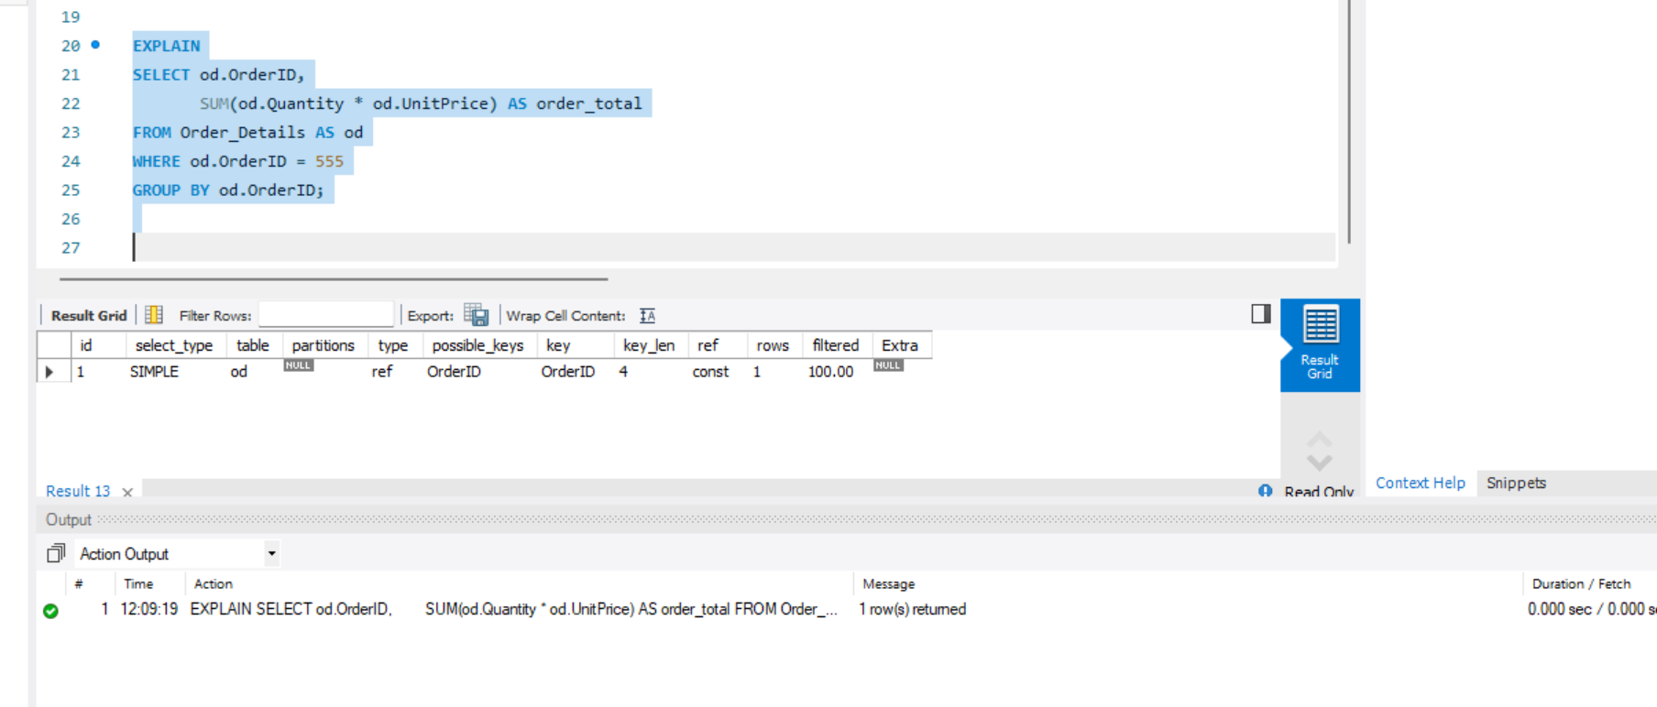
Performance Optimization
Case B — “Compute Order Total” (covering index → index-only aggregation)
Business question: “Compute the total amount for a single order.”
BEFORE
EXPLAIN
SELECT od.OrderID,
SUM(od.Quantity * od.UnitPrice) AS order_total
FROM Order_Details AS od
WHERE od.OrderID = 555
GROUP BY od.OrderID;
Typical BEFORE pattern
type: ALL (full scan) or ref (on OrderID)
For each matching row, the engine still fetches table rows to get Quantity & UnitPrice
Extra may not show “Using index”
Result

Slide 20
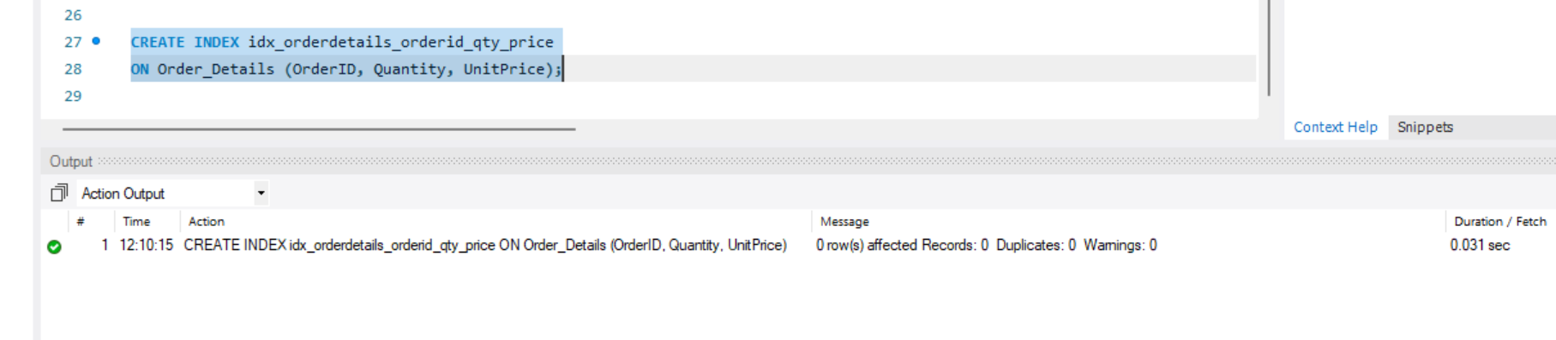
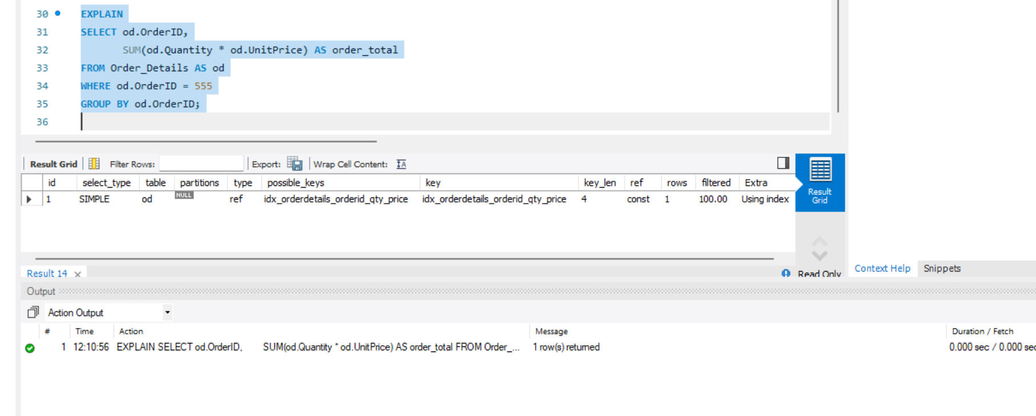
Performance Optimization
Case B — “Compute Order Total” (covering index → index-only aggregation)
Business question: “Compute the total amount for a single order.”
Create covering index (AFTER)
Put all columns used in the filter & aggregation into one index (covering):
CREATE INDEX idx_orderdetails_orderid_qty_price
ON Order_Details (OrderID, Quantity, UnitPrice);
Expected AFTER pattern
type: range/ref on OrderID
Extra: Using index (index-only scan)
Much lower random I/O
Business effect
Faster order totals for invoices and dashboards
Smooths checkout/CS workflows (totals appear instantly)
Resource savings → supports more concurrent users
Result

Slide 21
Conclusion
This project demonstrates the complete lifecycle of a data warehouse system: schema design, operational queries, analytics, transaction safety, and performance tuning.
For Best Buy, this system enables:
Operational efficiency: Fast and safe order processing.
Analytical insights: Product performance, sales trends, customer loyalty.
Scalability: Can handle millions of rows, ensuring reliability during peak sales.
Future Improvements
Automate ETL pipelines.
Integrate real-time dashboards.
Expand into predictive analytics with ML.

Slide 22
Thank You

